Slide 1


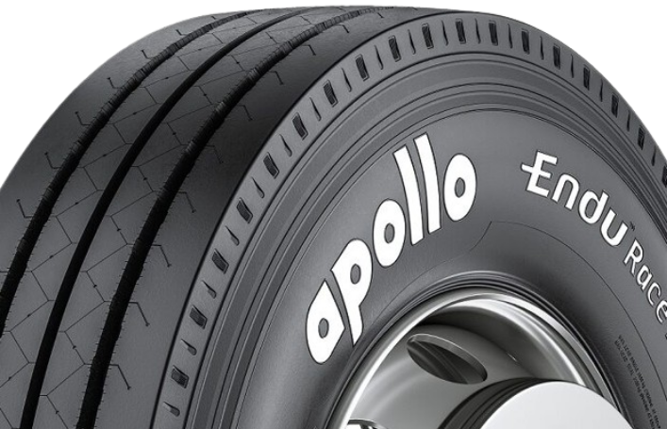
Equity Research
Report

Slide 2
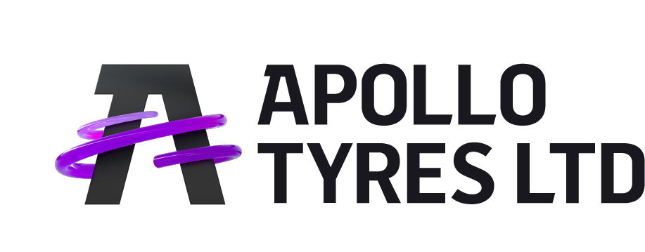

At a Glance
₹ 25,378 Cr.
Consolidated Revenue
Navigating pg
this Report no.
About the Company
Economy
Automotive Industry
Tyre Industry
Concall Analysis
Management Analysis
Corporate Governance Analysis
Financial Statement Analysis
Dupont Analysis
Relative Valuation
Peers Analysis
Analyst Coverage Universe
3
4
5
6-8
9
10-11
12-14
15-25
26-27
28
29-31
32
₹ 1728 Cr.
Net
Profit
₹ 3047 Cr.
Operating
Profit

Slide 3
Equity Research Report
Accelerating Profits with AI: Apollo Tyres' Capex-Light Revolution
Recommendation :XXX
CMP :INR 497
Target :XXX
About the Company
Apollo Tyres Ltd (Apollo Tyres or the Company) is an international tyre manufacturer and a leading brand in India. It is catering both OEM and replacement Segment. Incorporated in 1972 with their first manufacturing plant in Kerala, the company has two global brands, Apollo and Vredestein, which was acquired by Apollo Tyres in 2009. It has marketed its products in more than 100 countries with exclusive shops and multi-outlet stores. The product portfolio includes tyres for all categories of vehicles such as SUV, MUV, light truck, truck-bus, two-wheeler, agriculture, industrial, specialty, bicycle, and off-the-road tyres, as well as retreading material and tyres. In terms of the luxury segment for PCR, in India, They cover nearly 70% to 80% of the market. Through both brands, Apollo and Vredestein.
It is headquartered in Gurugram, India. The manufacturing plants are present in five locations in India: two in Cochin, one each in Vadodara, Chennai, and Andhra Pradesh. Outside India, it has two manufacturing plants located in the Netherlands and Hungary. It has 24 overseas subsidiaries.
Stock data (as on 17th May, 2024)
NIFTY | :22,355
52 Week H/L (INR) | :560 / 361
Market Cap (INR Cr) | :31,584
O/S Shares (Cr) | :63.5
Dividend Yield | :0.81%
Relative Stock Performance- 1 yr
Brief Overview
The Managing Director is very optimistic and bullish about the company's future prospects, confident that they are well-positioned to deliver superior and sustainable profitable growth. R&D will remain a key focus area for the company.
This quarter, the company outperformed in Europe in terms of revenue compared to the Indian market, with revenue increasing by 3.1% year over year. However, the management missed its growth target, having previously stated that revenue would grow in the mid-single digits, but instead, revenue declined by 5.1%.
The median PE for three years is 19, yet the stock is trading at 17.6 PE despite having an EPS of 28, which has seen noticeable growth. Therefore, there could be a chance of the share price improving in the future.
Shareholding (as on 31st March, 2024)
Promoter | :37.4%
FII | :18.2%
DII | :23.5%
Public | :20.9%
Absolute Return
1 Year | :32.67%
3 Years | :132.75%
5 Years | :175.89%
Key Highlights Q4 FY24
The company is operating at a 80%- 85% capacity level. Its revenue from operations has decreased by 5.1% to 6,252 Cr compared to the previous quarter and has seen a growth of 0.17% yoy.
For FY24, the consolidated revenue is 25,378.0 Cr, and it has been split into three regions: 30% of revenue comes from Europe, 67% of revenue comes from APMEA, while the rest comes from other regions.
In the same quarter of the previous year, the COGS was 76.01% of sales and it has decreased to 65.56% in this quarter.
EBITDA margin has decreased by 1.35% compared to the previous quarter and has seen a minimal growth of 0.4% yoy.
The net profit margin is 5.6%, amounting to 354 Cr, which decreased by 1.8%.
It announced a hike of 3% across all products to pass EPR-related costs in India
The total Capex which has been pour amounted 700 Cr, which was 800 Cr in previous FY
The company has reduced in consolidate INR 1800 Cr
Consolidated | FY23A | FY24A | FY25E | FY26E
In INR Cr
Net Revenue | 24,568.0 | 25,378.0 | 27,506.7 | 28,236.0
YOY Growth% | 17.3% | 3.3% | 8.4% | 2.7%
EBITDA | 3,397.0 | 4,524.0 | 4,580.3 | 5,124.0
EBITDA Margins% | 13.8% | 17.8% | 16.7% | 18.1%
PAT | 1,105.0 | 1,722.0 | 1,861.7 | 2,311.0
YOY Growth% | 72.9% | 55.8% | 8.1% | 24.1%
ROE | 9.0% | 12.9% | 12.5% | 12.5%
EPS | 17.4 | 27.1 | 29.3 | 36.4
EV/ EBITDA | 7.8 x | 7.4 x | 7.2 x | 7.3 x
Prepared by: Rohit Kumar
Guided by: Parth Verma

Slide 4
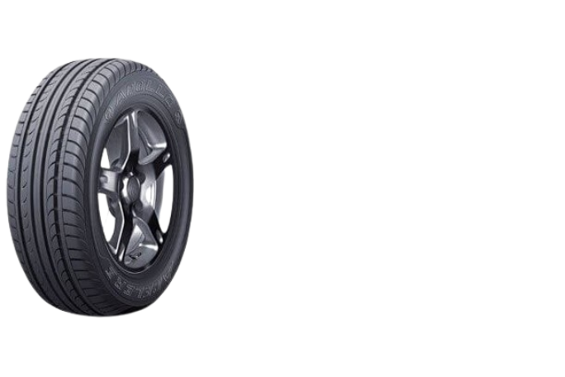
Global Economy
Globally, the economies witnessed skyrocketing growth after Covid-19 recovery. The world GDP increased by 6.1% in 2021, which was the highest ever in history due to a sudden spike in demand for goods and services in the economy post-Covid. Further, in February 2022, Russia invaded Ukraine, and the geopolitical tension arose, which affected the economy adversely. It caused disruption in the supply chain, inflation, and financial sector turmoil, which exposed snowball and cascading effects in the whole economy. As a result, central banks increased the interest rates to control inflation. According to the IMF, compared to CY21, countries posted a slower growth rate in the economy in CY22. The world output increased by 3.4% after a robust performance recorded in CY21.
Advanced economies (US, Euro Area, Japan) experienced lower GDP growth than the world, which was 2.7%, with the US managing only 2.1% in CY22 against 5.6% in CY21, while the Euro Area showed better growth than the US, at 3.5% in CY22 compared to 5.3% in CY21. The lowest growth among all advanced economies was recorded by Japan, as it grew by only 1.1% in CY22 compared to 1.6% in CY21. Emerging economies (India, China, UK) grew at a higher rate of 4.0% in CY22 compared to advanced economies. It was 7.3% in CY21. China still has not been able to get rid of the Covid-19 impact as its growth slowed down to 3.0%.
Source: IMF, WEO
Indian Economy
India persisted in its position and has emerged as one of the fastest-growing economies in the world compared to other economies, despite the consequences of the pandemic and geopolitical tensions arising from the Russia-Ukraine war. It became the fifth-largest economy, surpassing the UK. It recorded a GDP growth rate of 6.8% in CY22 compared to 9.1% in CY21, a far more ameliorated growth in relation to other economies. India recorded an overall GDP of $3.5 trillion in FY23. It has grown at a CAGR of 13.08% in nominal rupees term over 32 years. And now, India is aiming to become a $10 trillion economy by the end of FY2030. To achieve this growth, it has to grow at a CAGR of 16.2%. Of course, the number is not imaginary; the Indian government is engaged in deploying huge capital expenditure on infrastructures and technologies with massive R&D. In the midst of headwinds, the Indian government is doing whatever it takes. It has implemented multiple initiatives to support companies, such as PLI (Production Linked Incentives), National Logistic Reforms, digitization, and conducive domestic environment policies. It also assumed the G20 Presidency, which highlighted the global spotlight on India. India has outperformed the global growth rate. In CY23, the growth rate is 7.8%, and for CY24 and CY25, the growth rate is projected at 6.8% and 6.5%, respectively.
For Quarter (QTR) 4 2023, the actual GDP growth rate is 8.4% (increased by 0.8%), which beat the projected GDP growth of 6.6%. In QTR3 2023, the growth rate was 7.6%, which also beat the projection of 6.8%. For QTR1 2024, the projection is 6.9%, and the actual figure will be available soon.
Source: IMF, Worldometers
Acc. to CY, not as FY QTR
Source: IMF, Investing.com, livemint
Source: IMF, WEO, Apollo Tyres Annual Report FY23, Peers Annual Report FY23

Slide 5
Global Automotive Industry
The global automotive industry sales, including passenger and commercial vehicles, showed a dip of 2.3% compared to CY21. The cause of the decline was attributed to a sudden spike in demand for all items post-COVID-19 in CY21. Another crucial reason for this negative growth was the Russia-Ukraine war, which caused a price hike in fuel, leading to inflation. Eastern Europe’s vehicle sales drastically decreased by 59%, while Western Europe saw a marginal dip of 2.4%. This sharp decline in the European market was due to supply chain disruptions and component shortages throughout the year, affecting vehicle availability. The Asia Pacific region wasn’t affected as much, with recorded growth of 2.6%. CY23 saw positive growth of 5% compared to the previous year. The industry is expected to grow at a CAGR of 3.2% from 2024 to 2026.
The global EV market is emerging as a new sector, with significant investments in R&D from all automotive companies to accelerate growth. China is far ahead in this race, with 66% of global Li-ion battery manufacturing capacity, aiming for 40% of all cars sold to be electric by 2030. In CY22, 59% of EV sales were recorded in China, amounting to 5.9 million units, representing 29% of all light vehicles. Europe is the second-largest EV market, with a share of 29%, amounting to 2.39 million units. The US is still behind, with only 9% of all EV sales. In CY23, there was significant growth of 40% compared to 48% growth in CY22. The market is expected to grow at a CAGR of 23.4% by the end of 2026.
88.5
91.3
93.9
83.2
81.3
85.4
Source: Abiresearch
Source: ET, Precedence Research
Indian Automotive Industry
India has overtaken Japan in terms of automobile manufacturing and has become the third-largest manufacturer globally, following the US and China. The Indian automotive sector contributes 49% to manufacturing GDP and 7.5% to overall national GDP. The two-wheeler segment is dominant, with a 76% share, and the passenger vehicle share is 17.4%. As India continues to grow at a higher rate, all macro indicators will improve, leading to increased per capita income, higher disposable income, and urbanization. Urbanization is an important metric to consider, as currently, the urban population is only 30%, while the remaining 70% is rural. As people migrate to urban areas, the demand for passenger vehicles will increase to improve their standard of living.
In FY23, the growth of total automotive sales was 21.14% due to post-COVID recovery, and in FY24, it grew by 12.3%. In FY23, out of 21.2 million vehicles, 3.9 million were passenger vehicles, and 1 million were commercial vehicles. The passenger vehicle market is expected to grow at 9.6%, and the commercial vehicle market at 5.4%, with the overall automotive market growing at 4.7% from FY25 to FY27.
India will become a significant market for electric vehicles (EVs), with government support aimed at reducing fossil fuel consumption and promoting environmental sustainability. The government has launched multiple subsidies and schemes for purchasing EVs. FAME 1 continued from 2015 to 2019, followed by FAME 2 from 2019 to 2024 (till 31st March), with a subsidy amount of INR 10,000 per kWh. After four months, the government will introduce a new subsidy. In FY23, there was a massive increase in EV sales of 175.5%, and further growth of 34.6% in FY24. The CAGR of the Indian EV market is projected to be 22.4% from FY25 to FY27.
Source: Multiple Reports
Source: JMK Research & Analytics,

Slide 6
Global Tyre Industry
The global tyre market size for the year CY22 was $130.5 billion and saw a growth of 4.5% in CY23. It is expected to further grow at a CAGR of 4.8%. The Asia-Pacific region contributed more than 47% of the total revenue in CY22. By vehicle type, passenger vehicles constituted 41% of the total vehicle revenues. China dominates the global tyre market with a 50% share, followed by Europe, the US, India, and Japan. The tyre industry is not only capital-intensive but also material-intensive, as 70% of the total manufacturing cost is attributed to materials. During CY22, the industry faced several headwinds, causing price instability and affecting the availability of raw materials. As the year passed, commodity prices stabilized. The growth in OEMs provided relief to the overall industry, and there is a new market for tyres for EVs. The EV market could be both a barrier and an opportunity for the industry, as it requires tyres with advanced technologies that provide low rolling resistance for better range, durability to bear heavy batteries, and reduced noise while rolling. Consequently, companies are now shifting to electrification, as many countries, corporations, and car makers have pledged to eliminate the internal combustion engine by 2035. This becomes a crucial factor to consider. .For instance, in Nov 2019, Bridgestone made the first polymer “SUSYM” that combines rubber and resin. The company aims to provide durable tyres with high strength and resistance to low temperatures. The industry is also focusing on waste management and sustainability by recycling worn-out tyres
Source: Precedence Research, Smithers
Indian Tyre Industry
In FY22, the Indian tyre market size was $11.3 million, which increased by 16% in FY23, amounting to $13.1 million. It is projected to grow at a CAGR of 8.7% from FY24 to FY28. The Indian tyre industry is becoming a potential market for global companies and is on track to become the leading country in tyre manufacturing. Today, India has some of the finest radial tyre manufacturing facilities in the world. The government uses import duties as a tool to protect domestic manufacturing capacity and promote domestic production, forcing domestic players to reduce reliance on imports and start their own manufacturing facilities. The government's adherence to the "Make in India" policy is a major factor in the growth of the tyre industry. Another crucial factor is road infrastructure; the government is heavily investing in road infrastructure. In FY15, the total length of National Highways (NH) was 97,830 km, which increased to 144,634 km in FY23. This will not only improve the overall infrastructure but also lead to an increase in demand for new luxury vehicles. There is always a concern about tyre and vehicle life because of road quality. Due to geopolitical tensions, many countries are finding alternatives to China and want to reduce reliance on Chinese products. India exports tyres to 170 countries and is emerging as a major exporter to countries like Europe and the US. Other countries also use Indian tyres for their high-end models. India is the third largest producer of rubber after Indonesia and Brazil, with a total production volume of natural rubber in FY23 being 839,000 MT. The Indian tyre industry contributes 3% to the total manufacturing GDP and 0.5% directly to the overall GDP. The adoption of new technologies such as Industry 4.0, which utilizes Artificial Intelligence and Machine Learning, will increase the performance and safety of vehicles.
Source: ATMA, marketsanddata

Slide 7
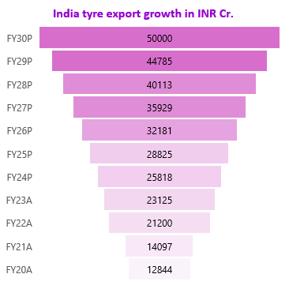
Capex
The capex of the Indian tyre industry has shown a cumulative investment of INR 35,000 crore over the last three years, from 2022 onwards, for the creation of new plants and debottlenecking. It aims to increase revenue up to INR 1 lakh crore in three years. The new capacity will serve and fulfill the growing demand in the domestic economy and other economies as well. There is an exponential rise in demand from rural areas for premium passenger vehicles, with a clear preference for SUVs, which will create demand for 16-inch wheels or larger. The tyre industry has been investing 10% of its revenue over the last three years to meet the growing demand, and it will continue to invest 10% to 12% of its revenue in the mid-term. The domestic sales of tyres will continue to grow at 8% to 9% (in amount). This rate is high as the driving factors will be the replacement demand and OEM demand. The demand momentum for OEMs in FY24 is estimated to grow at 8% to 10%, while the replacement demand, which forms two-thirds of tyre demand, is likely to grow at a mid-single-digit rate.
Source: ATMA, ICRA
Exports
The tyre industry in India nearly doubled from INR 12,844 Cr in FY20 to INR 23,125 Cr in FY23. The market has the potential to increase exports to INR 50,000 Cr by 2030. The total number of shipments exported to other countries stood at 2.4 Mn, exported by 8,845 exporters to 35,000 buyers across all countries. Tyres, which are sold to over 170 countries including the EU, Brazil, UK, and UAE, have been recognized for their quality. Currently, India stands at $3 bn in exports, which is over 25% of total industry revenues. The US has the largest market share of exports for India, constituting 25% of total exports. FTAs can bring more demand for the tyre industry in India. Signing FTA agreements with Latin America (Brazil, Argentina, Bolivia, Colombia) and African countries can increase exports.
Recently, Prime Minister Modi urged the industry to work with farms and reduce reliance on other countries for rubber imports, as the total industry consumption is 13 lakh MT, while India produces only 8 lakh MT of rubber. The government is trying to fill this gap by reducing dependency on other countries. Four major industry associations have committed to investing INR 1,100 Cr to set up 2 lakh hectares of land for rubber production in the northeastern area. Also, the Red Sea crisis is a significant issue for exporting tyres to other countries. The industry has yet to see the impact, but so far, it hasn't noticed any significant effects. Hopefully, it will be resolved soon.
Source: ATMA, Volza grow global
Source: tradestat.commerce.gov.in

Slide 8
Imports
India aims to achieve self-reliance in the tyre industry. It is one of the largest global producers and is capable of fulfilling the demand for the domestic market and even other countries. Despite this, it showed a 15% growth in FY23 with a value of INR 2100 crore. The industry also supports the livelihoods of farmers producing rubber, with the Indian tyre industry consuming about 70% of all rubber produced.
According to Volza's India import data, the total import shipments consisted of 223.5k, imported by 3,793 Indian importers from 5,386 suppliers. India imports most of its tires from Thailand, Japan, and the United States. The top three importers of tires are the US with 278k shipments, followed by Vietnam with 664k shipments, and Turkey with 235k shipments.
Until 2016, India had a great dependency on China for tyre imports, which amounted to INR 1,836 crore in 2016. This dependency reduced by 65.65% in 2019, amounting to only INR 630 crore. Due to geopolitical tensions between the countries, India has reduced its overall dependency on China. The import value in FY23 increased by 15% from the previous year, amounting to INR 2100 crore. Out of the total value, PCR (Passenger Car Radial) tyres have the largest share at 48% in terms of volume, followed by OTR (Off The Road)/Industrial tyres with a 22% share, and Motorcycle tyres with a 15% share.
Source: ATMA, Peer Report
Source: ATMA, Peer Reports, ICRA, Export genius
Source: ATMA, Peer Reports

Slide 9

Quarterly Result Analysis: Q3 FY24 and Q4 FY24
For Q3, the consolidated revenue was slightly lower at 6600 Cr, which represents a 5% increase from the previous quarter and a 2.6% increase from the same quarter of the previous year. For Q4, the consolidated revenue was more than 6250 Cr, which decreased by 5% from the previous quarter and was nearly the same as in the same quarter of the previous year.
For Q3, the consolidated EBITDA for the quarter stood at INR 1200 Cr, with a margin of 18.3% compared to 14.2% in the same period last year and slightly lower than the 18.5% in the previous quarter. For Q4, the consolidated EBITDA for the quarter stood at INR 1066 Cr, with a margin of 17.5% compared to 16.1% in the same period last year and 18.5% in the previous quarter. The target was 15%, but they have achieved 17.5%.
For Q3,The net profit margin was 7.5% while it was same in previous quarter and 4.5% in same quarter of previous year. For Q4 the net profit margin was 5.6%, it was 7.5% in last quarter and 6.5% in same quarter of previous year.
For Q3, the ROCE stood at 16.5% while in Q4, ROCE stood at 16% against our target range of 12% to 15%.
For Q3 and Q4, The net debt to EBITDA for the consolidated operations is at 0.7x and 0.6x respectively versus 1.4x in March 2023. There’s a debt reduction of INR 1100 Cr in current year in Indian operation. And consolidated around INR 1800 Cr. debt amount reduced.
For Q3, in India, the volume growth on a Y-o-Y basis was in the mid-single digits, driven by replacement demand and an increase in export channels. The truck volume growth was 3% and passenger car volume growth was 7%. Addressing the replacement market, the growth in the current quarter for trucks was an 8% volume increase and for passenger cars, it was a 4% increase. Additionally, It gained market share across all segments, including passenger cars, trucks, and agriculture. There was also healthy growth in Vredestein brand passenger car sales, with UHP continuing to perform well. It also gained OEM fitments for some of the biggest automotive companies globally. During this quarter, the company launched a new range for the domestic commercial vehicle market. For Q4, in India, the overall volume growth was 4%. There was significant growth in key segments with TBR replacement at 7% and PCR replacement at 10% for the quarter. The OEM segment witnessed a negative growth of 10%, and OE was almost flat. There was strong growth in the passenger car segment. Exports in the last quarter showed a very strong growth of over 30%. The lower growth in the top line, which was less than the industry, was due to negative growth in the truck OEM segment. Particularly, large high-capacity trucks sold less, and the growth came from the bus segment, which is less profitable. Apollo's new strategy is to focus on profitability, thus giving up certain sizes to focus on more profitable ones, particularly large sizes. Although it lost market share in the truck segment, growth came from the bus segment, which is less profitable. This is a major drawback as Apollo is not entering this less profitable segment.
In FY24, the actual capital expenditure (capex) fell short of the guidance provided due to curtailment. The projected capex was INR 1100 Cr, but only INR 700 Cr was expended. In Q3, it was stated that the capex would be INR 600 Cr, and the company achieved this. The company has been below capex expectations for the last two years as volumes have been lower than initially expected, indicating slower growth. The company is clear that for the next two years, they will adopt a capex-light model. With digitization, the company is noticing significant improvements in productivity across all plants. They estimate that productivity could increase by 10%-15% from the current equipment. They are very bullish on AI and machine learning. Currently, capacity is running at 80%-85%, but even if there is a surge in demand, they are ready to fulfill it. The capex guidance for FY25 is INR 1000 Cr.
For Q3, the raw material basket price increased by 2% lower than what was guided. For Q4, The raw materials prices is expected to rise by 4% to 5% in Q1 FY25, this will negate through increase in prices of product. Company has also announced 3% hike in all of the product across.
For Q3, In European Operation, the revenue recorded was EUR 176 million, up 4% sequentially, The EBITDA stood at EUR 36 million with margin of 20.3% compared to 15.4% for the same quarter last year and 14.1% in Sep quarter. The reason for this excellent margin is the product mix basket, as 45% of the total pie consist of UHP and UUHP and those are the larger profit pools which gives the better margin. Even in India, the product mix is becoming richer both in PCR and CV. There is no capex guidance for the current year. For Q4, Europe Operations, the revenue for the quarter was EUR 182 million, up 3% Y-o-Y. This was against a subdued market scenario, EBITDA margin performance of 19.1% compared to 18.1% for the same period last year. UUHP has gone to 47% of our total pie, this leads to better and healthier profit. They did launch the Vredestein brand in India, where we are seeing a good customer demand for the brand.

Slide 10
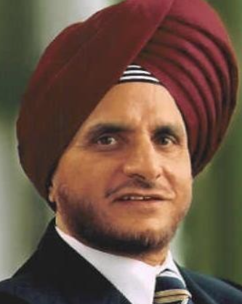
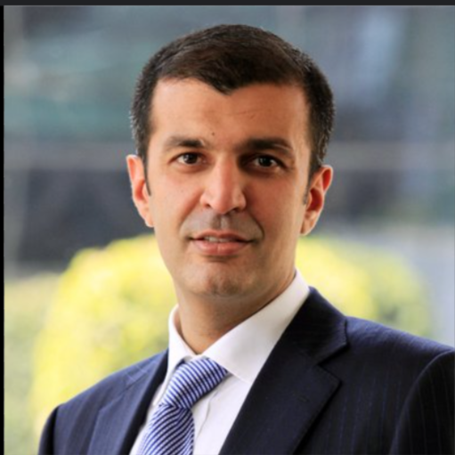
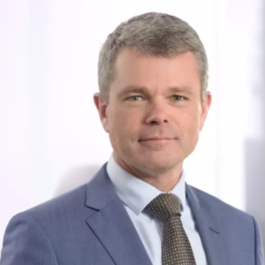
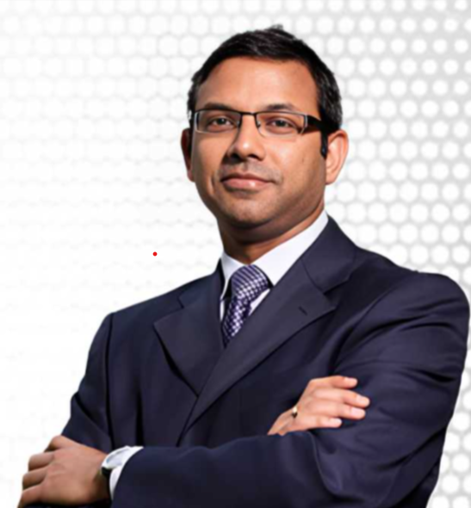
Management Analysis
S.NO | Name | Designation | Qualification/ Experience | Comments
1) |  | Co-founder & Chairman | Degree in Science and Administration, University of California. Worked as a salesman in Riverside, California. Worked for Abbey Etna Machine Company in Perrysburg, Ohio. Former president of FICCI. Former chairman of ATMA. Chairman of BRICS Council of India. Member of the Board of Governors at IIM Kozhikode. Member of the Trade Advisory Committee. | The entire senior management is led by Onkar Kanwar. He resurrected the whole business when it was about to sold and transformed the business in one of the leader in tyre industry. He was categorized as a political exposed person by the law firm’s compliances department as he served as a Board Member of the Kerala State Industrial Development Corporation. He also had feud with his father Runaq Singh because of financial irregularities by Onkar and brother Narinder Jeet Singh as Onkar was trying to take controls by improper means.
2) |  | Vice Chairman & Managing Director | Education from St. Columba's School, Delhi and thereafter graduated in engineering from Lehigh University in Pennsylvania, US. Started his career with a training stint at American Express Bank in New York City. Started Global Finance Ltd, a non-bank financial, shut after three years. First position in Apollo tyres was in the sales team. Acquisition of Dunlop tyres, South Africa under his supervision. Served as a Chairman in ATMA for three years | He plays a pivotal role in Apollo’s journey towards becoming one of the most admired tyre brands. He has pioneered key initiatives in enhancing the competitiveness of the Company’s operations and products across the Board. He is responsible for crafting Apollo’s growth story taking the Company from US$450 million to US$3 billion. He has acquired Vredestein and set up Greenfield facility in Hungary thereby transforming itself as a multi-geographic company across the globe
3) |  | President, Europe | A Mechanical Engineer, BA in Business from Montpellier University, France. Served as a coach to various running teams for several years in the past. Member of the company’s Management Board. Spent most of his work life with Michelin and has held various roles in the organization. His last assignment with Michelin was as Vice President, Asia, Earthmover and Industrial Tyres based out of Shanghai. He has also held Commercial Director portfolio for China and Hong Kong truck and bus tyres. | He had a great experienced in tyre industry which drives him to introduction of Commercial tyre in Europe. Being the association with about a decade and CEO of Apollo Vredestein, BV, he is responsible for the key functions of manufacturing, sales & marketing, customer relations and profitability in Europe.
4) |  | Chief Financial Officer | A degree in Mechanical Engineering from the IIT, Delhi, and a MBA in Finance from the FMS, Started with Management Trainee with UB Group in 1993. Managing Director of a manufacturing set-up to being part of Acquisition & Alliances team for an IT Giant. Joined Apollo Tyres Ltd as Head, Corporate Strategy. . In 2010, Kumar was nominated to the Company's Management Board. In 2015, became CFO of the Apollo tyres | He is responsible for overall financial health of the organisation and undertakes various projects, inorganic growth, M&A. He won the best CFO award at the ASSOCHAM 2nd Vibrant Bharat CFO Summit and Awards. THe board has given approval that he will be appointed as a new Whole Time Director from June 1 in place of Satish Kumar retirement
Onkar Kanwar
Neeraj Kanwar
Benoit Revallant
Gaurav Kumar

Slide 11
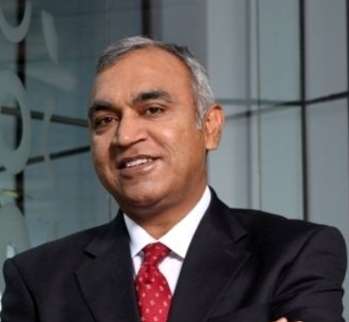
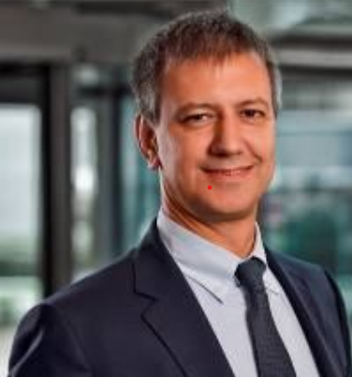
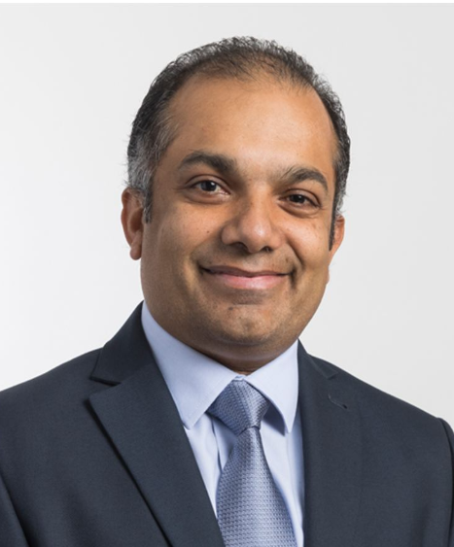
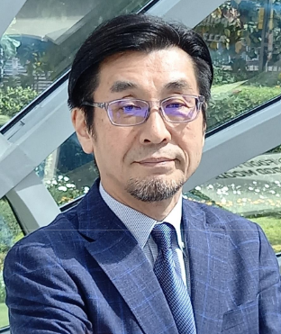
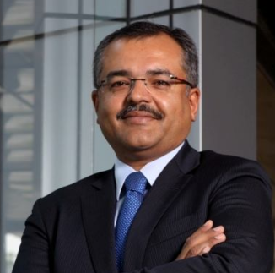
Management Analysis
S. N O | Name | Designation | Qualification/ Experience | Comments
5) |  | President (APMEA) and Whole-time Director | Chemical Engineer from the NIT, Raipur, MP, holds a post-graduate diploma in Business Management from IMT, Ghaziabad. Member of the Institute of Engineers, Indian Rubber Institute and All India Management Association (AIMA). Begin career with JK Tyres, moving very soon to the position of a Manager, where he was responsible for brand and product management | He is a man who prefers taking challenges head-on. He is credited with Apollo’s steady sales growth, in the last few years. Having been with Apollo Tyres for over two and a half decades, Satish Sharma is recognized as an industry veteran, having held various key positions. He elected as a chairman in ATMA in 2017. On May 31, he will retire from the organization.
6) |  | Chief Technology Officer | Industrial Chemical Engineering degree from University of Milan. He was a product director and developed product and Technological Road Map definition for Truck, Agro and Special Vehicles. Joined Apollo tyres in 2016 | Having 20 years experience in Pirelli Tyres, spent 20 years across different positions with his core areas of professional expertise being in technological innovations, product quality improvements, he aims to achieve product leadership for Apollo Tyres in various segments.
7) |  | Chief Digital Officer | Holds a bachelor’s degree in Electrical and Electronics Engineering from the University of Leeds, UK. Has 30+ years of rich experience having worked across areas of Supply Chain, Information Technology and Digital Enablement. | His last job was with Coats PLC, and before that, he worked at Unilever. At Coats, he oversaw Digital and Technology worldwide. He is known for transforming Coats' Global Technology department by implementing a cloud strategy and other modern technologies to support digital change.
8) |  | Chief Quality & Safety Officer | Bachelor of Materials Engineering from Shibaura Institute of Technology, Tokyo. Has 35 years of rich experience, predominantly in the Tyre and Automobile Industry, most of which has been in the Quality function. Previously associated with Bridgestone as its Vice President and Officer (Quality) | He plays a pivotal role in benchmarking, developing and implementing best management systems and processes in the organisation to achieve superior business results.
Satish Kumar
Daniele Lorenzetti
Hizmy Hassen
Yoichi Sato
9) |  | President & Chief Business Officer | A Commerce graduate from St. Xavier’s College, Kolkata, Also holds an International Masters in Practicing Management from Lancaster University, UK. In 1999, joined Apollo Tyres as Head, Marketing, Non Truck Tyres. . He took over as the CFO in 2009, and as Chief Business Officer in Nov 2014. He has been a Director on the Board of the company since 2004. | He has pioneered a number of initiatives that have had a significant impact on revenue, profitability, employee satisfaction and customer delight. In his previous role as the CFO, had successfully led and executed Apollo’s international acquisitions and greatly strengthening the company’s Balance Sheet.
Sunam Sarkar

Slide 12
Commentary
The executive leadership team consists of highly skilled individuals with diverse qualifications. Onkar took charge of the business during a challenging period and led its impressive growth, both domestically and internationally. He has also served as the Chairman of the BRICS Council of India. The Board of Directors comprises professionals from various fields, including law, civil service, military, finance, and corporate law. Neeraj Kanwar, the Managing Director and Vice Chairman, has shown exceptional leadership abilities. He successfully oversaw the acquisition of Vredestein and Dunlop Tyres and spearheaded the establishment of a new facility in Hungary, showcasing his commitment to global expansion. Mr. Kanwar is confident in the potential of AI and machine learning to improve operational efficiency. Under his leadership, Apollo Tyres has experienced significant growth, increasing its revenue from $450 million to $3 billion. Executive appointments are made based on rigorous assessment of competencies and technical expertise. While Mr. Neeraj has led the organization for two decades, other members of the management team have been with the company for over five years, illustrating their dedication to the company's goals.
Shareholding Pattern
The company's shareholding distribution indicates that Foreign Institutional Investors (FIIs), Domestic Institutional Investors (DIIs), and the public collectively hold 61% of the total shares, while promoters hold 37%, a reduction from FY17. The DIIs' stake has significantly increased from 8% in FY17 to 22% in FY24, while FIIs' holdings have decreased. Notably, the promoters' pledged shares were 3.05% in March 2022, progressively decreasing to 1.07% in March 2024. It is important to note that a strategic exit by promoters can sometimes lead to a loss of confidence among investors.
Quarterly Shareholders Holdings
Shareholders | Jun-21 | Sep-21 | Dec-21 | Mar-22 | Jun-22 | Sep-22 | Dec-22 | Mar-23 | Jun-23 | Sep-23 | Dec-23 | Mar-24
Promoters | 38% | 37% | 37% | 37% | 37% | 37% | 37% | 37% | 37% | 37% | 37% | 37%
FIIs | 23% | 20% | 20% | 19% | 21% | 22% | 23% | 22% | 23% | 22% | 18% | 18%
DIIs | 16% | 18% | 18% | 19% | 17% | 18% | 17% | 18% | 17% | 18% | 22% | 22%
Government | 2% | 2% | 2% | 2% | 2% | 2% | 2% | 2% | 2% | 2% | 2% | 2%
Public | 22% | 23% | 23% | 23% | 23% | 21% | 21% | 21% | 20% | 21% | 21% | 21%
Yearly Shareholders Holdings
Shareholders | Mar-17 | Mar-18 | Mar-19 | Mar-20 | Mar-21 | Mar-22 | Mar-23 | Mar-24
Promoters | 44% | 40% | 41% | 41% | 37% | 37% | 37% | 37%
FIIs | 31% | 24% | 19% | 23% | 24% | 19% | 22% | 18%
DIIs | 8% | 20% | 22% | 17% | 12% | 19% | 18% | 22%
Government | 2% | 2% | 2% | 2% | 2% | 2% | 2% | 2%
Public | 14% | 14% | 16% | 17% | 25% | 23% | 21% | 21%
Source: Company Analysis, Trendlyne

Slide 13
Remuneration
Details of Medium Remuneration/ Salary wages with peer group (in lakhs)
 | Male |  |  |  | Female
Companies | Board of Directors (BoD) | Key Managerial Personnel (KMP) | Employees other than BoD and KMP | Workers | Board of Directors (BoD) | Key Managerial Personnel (KMP) | Employees other than BoD and KMP | Workers
Apollo Tyres | 3135 | 4733 | 9.2 | 7.2 | 114 | 102 | 16.5 | 2.7
Jk Tyres | 1073 | 2118 | 9.4 | 5.2 | - | - | 8.5 | 8.8
Bal Krishna | 47.3 | 205 | 7 | 3.05 | 5.5 | - | 6.2 | -
Ceat | 22 | 326 | 2.6 | 7.5 | 17 | 64.6 | 2 | -
MRF | 2186 | 192 | 6.1 | 5.4 | - | 6.2 | 9.1 | -
Good year | 291 | 49 | 14.6 | 10.6 | - | - | 21.4 | 3.7
Ratio of median remuneration ratio of BoD and KMP to employee with peers
 | Male |  | Female
Companies | Board of Directors (BoD) | Key Managerial Personnel (KMP) | Board of Directors (BoD) | Key Managerial Personnel (KMP)
Apollo Tyres | 340.7x | 514.5x | 6.9x | 6.2x
Jk Tyres | 114.1x | 225.3x | - | -
Bal Krishna | 6.8x | 29.3x | 0.9x | -
Ceat | 8.5x | 125.4x | 8.5x | 32.3x
MRF | 358.4x | 31.5x | - | 0.7x
Good year | 19.9x | 3.4x | - | -
Key managerial personnel ( in Rs. Millions)
Particulars | FY 23 | FY 22
Managerial remuneration:
Mr. Onkar Kanwar | 270.59 | 140.14
Mr. Neeraj Kanwar | 284.12 | 122.62
Mr. Satish Sharma | 99.7 | 89.58
Total: | 654.41 | 352.34
Sitting fees:
Non-executive directors | 4.29 | 4.13
Commission:
Non-executive directors | 50 | 38
Source: Company Annual Report

Slide 14
Commentary
Remuneration
The remuneration of male Board of Directors (BoD) and Key Managerial Personnel (KMP) is the highest among the median of peers. The ratio of the median salary of male BoD to the median salary of employees is 341x, which is the second highest among peers. The ratio of the median salary of male KMP to the median salary of employees is significantly higher than that of peers, standing at 515x. There is a substantial gap between the remuneration of male and female BoD members, with male BoD remuneration being 28 times greater than that of female BoD members. For KMP, male remuneration is 46 times greater than female remuneration, indicating male dominance in the organization. In FY23, where the net profit grew by 73%, Mr. Onkar’s remuneration increased by 93%, amounting to Rs. 27 Crore. Mr. Neeraj Kanwar's remuneration increased by 132%, amounting to Rs. 28 Crore. In contrast, Mr. Satish Sharma, a Whole-time Director, had a salary increase of only 11%, amounting to approximately Rs. 10 Crore. The total KMP remuneration constitutes about 5.8% of the total net profit. The ratio of remuneration of each executive director to the median remuneration of employees for FY2023 is as follows: Mr. Onkar Kanwar – 226x, Mr. Neeraj Kanwar – 237x, and Mr. Satish Sharma – 83x.The company provided an average remuneration of Rs. 5.36 million to non-executive directors, which increased by 25% from the previous year. The ratio to the median salaries of employees is 4.47. From FY19 to FY24, the remuneration of KMP has generally aligned with changes in net profit, except for FY21,despite a significant increase in net profit, remuneration was less than in the previous year. In FY20, during the COVID-19 pandemic, KMP took a 35% reduction in remuneration compared to the previous year, demonstrating the management's commitment to the organization during tough times. The top management voluntarily took pay cuts to account for the impact of the COVID-19 pandemic on the automotive industry. Chairman and Managing Director Onkar S. Kanwar and Vice CMD Neeraj Kanwar each took a 25% pay cut, while the senior management took a 15% reduction in their salaries.
Efficiency of the BoD
During FY23, the company's Board of Directors (BoD) managed the company efficiently. Most board members attended all the board meetings, demonstrating their strong involvement in key discussions throughout the year. The company also has a good number of independent directors from diverse industries and respected professions, including advocates, IAS officers, Indian Foreign Service officers, Chiefs of Army Staff, investment bankers, and corporate lawyers. This diversity and expertise on the board have strengthened the decision-making process. Here are the details of the BoD participation:
Name/ Designation of Director | Executive/ Non- Executive/ Independent | No. of Board Meetings held/attended during tenure of the Director |  | Attendance at last AGM
 |  | Held | Attended
Mr. Onkar Kanwar, Chairman | Promoter and Non- Executive | 5 | 5 | Yes
Nr. Neeraj Kanwar, Vice Chairman & Managing Director | Executive | 5 | 5 | Yes
Mr. Satish Sharma, Whole Time Director | Executive | 5 | 5 | Yes
Mr. Akshay Chudasama | Non-Executive Independent | 5 | 3 | Yes
Gen. Bikram Singh (Retd.) | Non-Executive Independent | 5 | 5 | Yes
Mr. Francesco Crispino | Non-Executive Independent | 5 | 4 | Yes
Ms. Lakshmi Puri | Non -Executive Independent | 5 | 5 | Yes
Ms. Pallavi Shroff | Non -Executive Independent | 5 | 3 | Yes
Mr. Vikram S. Mehta | Non -Executive Independent | 5 | 5 | Yes
Ms. Vinod Rai | Non -Executive Independent | 5 | 5 | Yes
Dr. Jaimini Bhagwati | Non -Executive Independent | 2 | 2 | NA
Mr. Francesco Gori | Non -Executive Non-Independent | 5 | 5 | Yes
Mr. Robert Steinmetz | Non- Executive Non-Independent | 5 | 5 | Yes
Mr. Sunam Sarkar | Non- Executive Non-Independent | 5 | 5 | Yes
Mr. Vishal Mahadevia | Non -Executive Non-Independent | 5 | 5 | Yes
Source: Company Annual Report

Slide 15
Financial Analysis
Consolidated
Quarterly Snapshot
In Crores
Particulars | Jun-22 | Sep-22 | Dec-22 | Mar-23 | Jun-23 | Sep-23 | Dec-23 | Mar-24
Revenue | ₹ 5,942.00 | ₹ 5,956.00 | ₹ 6,423.00 | ₹ 6,247.00 | ₹ 6,245.00 | ₹ 6,280.00 | ₹ 6,595.00 | ₹ 6,258.00
Total Expense | ₹ (5,241.00) | ₹ (5,237.00) | ₹ (5,502.00) | ₹ (5,209.00) | ₹ (5,171.00) | ₹ (5,107.00) | ₹ (5,384.00) | ₹ (5,192.00)
EBITDA | ₹ 701.00 | ₹ 719.00 | ₹ 921.00 | ₹ 1,038.00 | ₹ 1,074.00 | ₹ 1,173.00 | ₹ 1,211.00 | ₹ 1,066.00
EBITDA Margin % | 11.80% | 12.07% | 14.34% | 16.62% | 17.20% | 18.68% | 18.36% | 17.03%
Interest | ₹ (118.00) | ₹ (132.00) | ₹ (142.00) | ₹ (139.00) | ₹ (135.00) | ₹ (133.00) | ₹ (123.00) | ₹ (115.00)
Depreciation | ₹ (344.00) | ₹ (349.00) | ₹ (354.00) | ₹ (372.00) | ₹ (362.00) | ₹ (360.00) | ₹ (368.00) | ₹ (388.00)
EBT | ₹ 239.00 | ₹ 238.00 | ₹ 425.00 | ₹ 527.00 | ₹ 577.00 | ₹ 680.00 | ₹ 720.00 | ₹ 563.00
EBT Margin % | 4.02% | 4.00% | 6.62% | 8.44% | 9.24% | 10.83% | 10.92% | 9.00%
Tax | 20% | 25% | 31% | 22% | 31% | 30% | 31% | 37%
Net Profit | ₹ 191.20 | ₹ 178.50 | ₹ 293.25 | ₹ 411.06 | ₹ 398.13 | ₹ 476.00 | ₹ 496.80 | ₹ 354.69
Net Profit Margin | 3.22% | 3.00% | 4.57% | 6.58% | 6.38% | 7.58% | 7.53% | 5.67%
EPS | ₹ 3.01 | ₹ 2.81 | ₹ 4.62 | ₹ 6.47 | ₹ 6.27 | ₹ 7.50 | ₹ 7.82 | ₹ 5.59
Consolidated
Yearly Snapshot
In Crores
Particulars | 2019 | 2020 | 2021 | 2022 | 2023 | 2024 | 2025E | 2026E
Revenue | ₹ 17,549.00 | ₹ 16,350.00 | ₹ 17,397.00 | ₹ 20,948.00 | ₹ 24,568.00 | ₹ 25,378.00 | ₹ 27,394.00 | ₹ 29,331.00
Total Expense | ₹ (15,650.00) | ₹ (14,368.00) | ₹ (15,057.00) | ₹ (18,235.00) | ₹ (21,171.00) | ₹ (20,853.00) | ₹ (22,718.00) | ₹ (24,372.00)
EBITDA | ₹ 1,899.00 | ₹ 1,982.00 | ₹ 2,340.00 | ₹ 2,713.00 | ₹ 3,397.00 | ₹ 4,525.00 | ₹ 4,676.00 | ₹ 4,959.00
EBITDA Margin % | 10.82% | 12.12% | 13.45% | 12.95% | 13.83% | 17.83% | 17.07% | 16.91%
Interest | ₹ (199.00) | ₹ (300.00) | ₹ (463.00) | ₹ (465.00) | ₹ (551.00) | ₹ (506.00) | ₹ (644.19) | ₹ (629.32)
Depreciation | ₹ (813.00) | ₹ (1,138.00) | ₹ (1,315.00) | ₹ (1,400.00) | ₹ (1,419.00) | ₹ (1,478.00) | ₹ (1,288.39) | ₹ (1,258.63)
EBT | ₹ 887.00 | ₹ 544.00 | ₹ 562.00 | ₹ 848.00 | ₹ 1,427.00 | ₹ 2,541.00 | ₹ 2,743.42 | ₹ 3,071.05
EBT Margin % | 5.05% | 3.33% | 3.23% | 4.05% | 5.81% | 10.01% | 10.01% | 10.47%
Tax | 23% | 12% | 38% | 25% | 23% | 32% | 24% | 24%
Net Profit | ₹ 682.99 | ₹ 478.72 | ₹ 348.44 | ₹ 636.00 | ₹ 1,098.79 | ₹ 1,727.88 | ₹ 2,085.00 | ₹ 2,334.00
Net Profit Margin | 3.89% | 2.93% | 2.00% | 3.04% | 4.47% | 6.81% | 7.61% | 7.96%
EPS | ₹ 11.89 | ₹ 8.33 | ₹ 5.49 | ₹ 10.02 | ₹ 17.30 | ₹ 27.21 | ₹ 32.83 | ₹ 36.76
Source: Company Analysis, Consensus

Slide 16
Consolidated
Annual Balance Sheet
In Crores
Balance Sheet | Mar-18 | Mar-19 | Mar-20 | Mar-21 | Mar-22 | Mar-23 | Mar-24
Equity Share Capital | ₹ 57.21 | ₹ 57.21 | ₹ 57.21 | ₹ 63.51 | ₹ 63.51 | ₹ 63.51 | ₹ 63.51
Reserves | ₹ 9,719.47 | ₹ 9,982.61 | ₹ 9,872.81 | ₹ 11,379.62 | ₹ 11,688.62 | ₹ 12,814.27 | ₹ 13,838.68
Borrowings | ₹ 4,661.15 | ₹ 5,110.76 | ₹ 6,763.89 | ₹ 7,333.51 | ₹ 7,060.91 | ₹ 6,420.53 | ₹ 4,905.10
Other Liabilities | ₹ 5,619.84 | ₹ 5,000.31 | ₹ 6,511.57 | ₹ 7,039.78 | ₹ 8,228.24 | ₹ 7,989.00 | ₹ 8,150.06
Total Liabilities | ₹ 20,057.67 | ₹ 20,150.89 | ₹ 23,205.48 | ₹ 25,816.42 | ₹ 27,041.28 | ₹ 27,287.31 | ₹ 26,957.35
Fixed Assets Net Block | ₹ 10,403.08 | ₹ 11,754.02 | ₹ 15,448.40 | ₹ 16,419.57 | ₹ 17,591.32 | ₹ 17,652.94 | ₹ 17,071.15
Capital Work in Progress | ₹ 2,304.07 | ₹ 1,539.30 | ₹ 1,641.98 | ₹ 1,106.51 | ₹ 618.23 | ₹ 252.56 | ₹ 282.98
Investments | ₹ 1,342.50 | ₹ 6.02 | ₹ 19.42 | ₹ 109.61 | ₹ 481.26 | ₹ 435.77 | ₹ 531.66
Total Non-Current Assets | ₹ 14,049.65 | ₹ 13,299.34 | ₹ 17,109.80 | ₹ 17,635.69 | ₹ 18,690.81 | ₹ 18,341.27 | ₹ 17,885.79
Receivables | ₹ 1,435.03 | ₹ 1,314.36 | ₹ 939.88 | ₹ 1,380.82 | ₹ 2,051.29 | ₹ 2,488.53 | ₹ 2,664.84
Inventory | ₹ 2,945.35 | ₹ 3,484.09 | ₹ 3,206.92 | ₹ 3,318.53 | ₹ 4,155.39 | ₹ 4,428.46 | ₹ 4,245.73
Cash & Bank | ₹ 599.19 | ₹ 562.65 | ₹ 749.60 | ₹ 2,145.79 | ₹ 1,080.66 | ₹ 846.23 | ₹ 922.13
Other Assets | ₹ 1,028.45 | ₹ 1,490.45 | ₹ 1,199.28 | ₹ 1,335.59 | ₹ 1,063.13 | ₹ 1,182.82 | ₹ 1,238.86
Total Current Assets | ₹ 6,008.02 | ₹ 6,851.55 | ₹ 6,095.68 | ₹ 8,180.73 | ₹ 8,350.47 | ₹ 8,946.04 | ₹ 9,071.56
Total Assets | ₹ 20,057.67 | ₹ 20,150.89 | ₹ 23,205.48 | ₹ 25,816.42 | ₹ 27,041.28 | ₹ 27,287.31 | ₹ 26,957.35
Ratios
Source: Company Analysis, Consensus

Slide 17
Revenue Analysis
The CAGR of the tyre industry's revenue, encompassing peer companies, was 9.0% over the past five years from FY19. In comparison, Apollo Tyres achieved a slightly lower CAGR of 7.6%. In FY24, the industry's median growth rate was 2.44%, while Apollo Tyres outperformed with a growth rate of 3.30%. Although this is higher than the industry median, it is not considered particularly strong. In Q1, Apollo's European operations underperformed, with revenue declining by 5% year-over-year and margins shrinking by 1% due to high fixed costs and the negative impact of operating leverage. Conversely, the Indian operations performed well, achieving a 2% increase in EBITDA margin compared to the previous quarter. In Q3, Apollo Tyres experienced a volume growth of 3% in truck tyres and 7% in passenger car tyres. The volume growth for replacement truck tyres was 8% and 4% for passenger car tyres. Exports in Q3 increased by 30%, significantly boosting revenue by 5% from the previous quarter. However, in Q4, the OEM volume growth was negative, particularly for truck OEMs, which saw a 10% decline due to lower truck sales, while the OE segment remained flat. The replacement growth for TBR tyres was 7%, and PCR tyres was 10% in volume terms. Apollo Tyres has lost market share in the truck segment, with growth primarily driven by the bus segment, which is less profitable. The company is shifting its focus towards the more profitable segments, particularly large-size tyres such as 16-inch and 17-inch. The highest growth was observed in passenger car tyres, and the recent launch of the Vredestein brand in India has contributed to growth in the UHP segment, which is more profitable. Apollo Tyres is prioritizing improving its bottom line over expanding into less profitable segments. Notably, Apollo's EBITDA margin has improved significantly from 12.49% in FY18 to 17.83% in FY19, outperforming the median growth of its peers.
CAGR (last 5 yrs)
Co. | CAGR ( last 5 Yrs)
Balkrishna | 12.00%
Ceat | 11.00%
JK Tyres | 8.00%
MRF | 9.00%
TVS Tyres | 4.00%
Median | 9.00%
Mean | 8.80%
Apollo Tyres | 7.66%
Sales Growth%
Companies | FY18 | FY19 | FY20 | FY21 | FY22 | FY23 | FY24
Balkrishna | 19.35% | 17.24% | -7.65% | 20.20% | 43.44% | 17.65% | -4.00%
Ceat | 8.95% | 11.17% | -2.94% | 12.26% | 23.05% | 20.84% | 5.56%
JK Tyres | 7.58% | 25.33% | -15.87% | 4.35% | 31.65% | 22.21% | 2.44%
MRF | 11.50% | 7.41% | 1.09% | -0.46% | 19.52% | 19.11% | 9.39%
TVS Tyres | 9.78% | 12.95% | -13.46% | -7.82% | 31.13% | 17.38% | -1.98%
Median | 9.78% | 12.95% | -7.65% | 4.35% | 31.13% | 19.11% | 2.44%
Mean | 11.43% | 14.82% | -7.77% | 5.71% | 29.76% | 19.44% | 2.28%
Apollo Tyres | 12.62% | 18.23% | -6.83% | 6.40% | 20.41% | 17.28% | 3.30%
EBITDA Growth%
Companies | FY18 | FY19 | FY20 | FY21 | FY22 | FY23 | FY24
Balkrishna | 4.17% | 5.50% | 0.15% | 30.12% | 23.39% | -16.06% | 31.68%
Ceat | -8.41% | 3.47% | 11.02% | 36.42% | -26.46% | 31.01% | 67.14%
JK Tyres | -31.19% | 27.01% | -17.81% | 52.40% | -19.72% | 14.31% | 64.57%
MRF | -12.04% | 4.40% | -0.58% | 16.26% | -24.80% | 11.51% | 72.52%
TVS Tyres | -6.93% | 2.45% | -17.56% | 3.54% | -26.28% | 36.92% | 24.11%
Median | -8.41% | 4.40% | -0.58% | 30.12% | -24.80% | 14.31% | 64.57%
Mean | -10.88% | 8.57% | -4.95% | 27.75% | -14.77% | 15.54% | 52.00%
Apollo Tyres | -11.55% | 6.57% | 4.33% | 18.04% | 15.96% | 25.23% | 33.18%
EBITDA Margin%
Companies | FY18 | FY19 | FY20 | FY21 | FY22 | FY23 | FY24
Balkrishna | 25.45% | 22.82% | 23.91% | 27.09% | 24.01% | 15.20% | 21.92%
Ceat | 10.18% | 9.47% | 10.84% | 13.17% | 7.87% | 8.53% | 13.51%
JK Tyres | 10.54% | 10.68% | 10.43% | 15.24% | 9.29% | 8.69% | 13.96%
MRF | 17.51% | 17.02% | 16.74% | 19.55% | 12.30% | 11.51% | 18.16%
TVS Tyres | 12.49% | 11.33% | 10.79% | 12.12% | 6.82% | 7.95% | 10.06%
Median | 12.49% | 11.33% | 10.84% | 15.24% | 9.29% | 8.69% | 13.96%
Mean | 15.23% | 14.26% | 14.54% | 17.43% | 12.06% | 10.38% | 15.52%
Apollo Tyres | 12.01% | 10.82% | 12.12% | 13.45% | 12.95% | 13.83% | 17.83%

Slide 18
Revenue Mix – FY24
Consolidated
Standalone
Consolidated
Source: Company Concalls

Slide 19
Trade Receivables
The company's trade receivables (TR) are increasing at a compound annual growth rate (CAGR) of 15.8%, which surpasses the median CAGR growth of peers' trade receivables by twice. In FY24, the growth in TR was notably less compared to the median growth of peers' TR, recording 7% against 21%, due to a lower sales growth of only 3.3% in FY24. In the first half of the fiscal year, there was an increase in receivables attributed to a significant rise in the original equipment (OE) business, which followed the normal receivable days. In FY23, both sales and trade receivables increased at approximately the same rate. Post-COVID-19, the company's trade receivables demonstrated a dramatic increase compared to the industry, growing by 47% against a median industry growth of 18%. During the COVID-19 pandemic in FY20, the company's trade receivables decreased by 28%, a sharper decline than the industry's 5% decrease. From FY18 to FY24, Apollo Tyres consistently maintained lower trade receivable days compared to the industry average.
The company is highly efficient in cash collection, with debtor days significantly lower than the industry median—38 days compared to 42 days. This efficiency indicates that while the company focuses on sales, even if on credit, it ensures prompt recovery of amounts due. Apollo Tyres' ability to recover cash from debtors within 38 days underscores its effective cash collection practices.
CAGR (last 5 yrs)
Co. | CAGR ( last 5 Yrs)
Balkrishna | 22.82%
Ceat | 12.68%
JK Tyres | 7.21%
MRF | 4.09%
TVS Tyres | -3.46%
Median | 7.21%
Mean | 8.67%
Apollo Tyres | 15.18%
Trade Receivables
Co. | FY18 | FY19 | FY20 | FY21 | FY22 | FY23 | FY24
Balkrishna | 480 | 517 | 590 | 754 | 1096 | 1115 | 1445
% Change |  | 8% | 14% | 28% | 45% | 2% | 30%
Ceat | 747 | 706 | 674 | 922 | 1154 | 1307 | 1283
% Change |  | -5% | -5% | 37% | 25% | 13% | -2%
JK Tyres | 1545 | 1945 | 1848 | 1575 | 1980 | 2283 | 2754
% Change |  | 26% | -5% | -15% | 26% | 15% | 21%
MRF | 2150 | 2383 | 2299 | 2146 | 2333 | 2503 | 2912
% Change |  | 11% | -3% | -7% | 9% | 7% | 16%
TVS Tyres | 244 | 337 | 207 | 245 | 240 | 221 | 282
% Change |  | 38% | -38% | 18% | -2% | -8% | 28%
Median |  | 11% | -5% | 18% | 25% | 7% | 21%
Mean |  | 15% | -7% | 12% | 21% | 6% | 19%
Apollo Tyres | 1435 | 1314 | 940 | 1381 | 2051 | 2489 | 2665
%Change |  | -8% | -28% | 47% | 49% | 21% | 7%
c
Debtor days
Co. | FY18 | FY19 | FY20 | FY21 | FY22 | FY23 | FY24
Balkrishna | 39 | 36 | 45 | 48 | 48 | 42 | 56
Ceat | 43 | 37 | 36 | 44 | 45 | 42 | 39
JK Tyres | 85 | 68 | 68 | 77 | 63 | 60 | 57
MRF | 52 | 54 | 52 | 48 | 44 | 40 | 42
TVS Tyres | 41 | 51 | 36 | 46 | 34 | 27 | 35
Median | 43 | 51 | 45 | 48 | 45 | 42 | 42
Mean | 52 | 49 | 47 | 53 | 47 | 42 | 46
Apollo Tyres | 35 | 27 | 21 | 29 | 36 | 37 | 38

Slide 20
Trade Payables
The company's creditors are increasing at a compound annual growth rate (CAGR) of 7.6%, which is lower than the industry median of 9.2%. In FY24, the company's creditors decreased by 11%, and total purchases decreased by 10%. The company's payable days have been reduced significantly, from 106 days in FY18 to 80 days in FY24, reflecting considerable improvement. In comparison, the industry maintains a lower average of approximately 74 payable days.
The company's decision to pay its creditors earlier has led to an increase in working capital requirements in the first half of FY24. In some cases, adhering to the normal payment cycle or making early payments has been financially advantageous due to cost considerations. This proactive approach to managing payables demonstrates the company's commitment to optimizing financial operations and maintaining strong relationships with its suppliers.
CAGR (last 5 yrs)
Co. | CAGR ( last 5 Yrs)
Balkrishna | 18.71%
Ceat | 17.24%
JK Tyres | 6.17%
MRF | 9.19%
TVS Tyres | 3.71%
Median | 9.19%
Mean | 11.00%
Apollo Tyres | 7.59%
Trade Payables
Co. | FY18 | FY19 | FY20 | FY21 | FY22 | FY23 | FY24
Balkrishna | 409 | 386 | 384 | 655 | 829 | 492 | 910
% Change |  | -6% | -1% | 71% | 27% | -41% | 85%
Ceat | 871 | 1053 | 1195 | 1839 | 2158 | 2268 | 2332
% Change |  | 21% | 13% | 54% | 17% | 5% | 3%
JK Tyres | 1165 | 1599 | 1688 | 1574 | 2189 | 1820 | 2157
% Change |  | 37% | 6% | -7% | 39% | -17% | 19%
MRF | 1569 | 1709 | 1905 | 3306 | 2057 | 2436 | 2653
% Change |  | 9% | 11% | 74% | -38% | 18% | 9%
TVS Tyres | 174 | 335 | 218 | 292 | 417 | 413 | 402
% Change |  | 93% | -35% | 34% | 43% | -1% | -3%
Median |  | 21% | 6% | 54% | 27% | -1% | 9%
Mean |  | 31% | -1% | 45% | 18% | -7% | 23%
Apollo Tyres | 2447 | 2066 | 2309 | 2807 | 3531 | 3354 | 2979
%Change |  | -16% | 12% | 22% | 26% | -5% | -11%
Days Payable
Co. | FY18 | FY19 | FY20 | FY21 | FY22 | FY23 | FY24
Balkrishna | 70 | 58 | 65 | 103 | 80 | 37 | 74
Ceat | 83 | 92 | 111 | 157 | 131 | 112 | 123
JK Tyres | 102 | 81 | 87 | 115 | 105 | 99 | 66
MRF | 63 | 64 | 72 | 129 | 60 | 58 | 64
TVS Tyres | 50 | 83 | 70 | 102 | 102 | 85 | 91
Median | 70 | 81 | 72 | 115 | 102 | 85 | 74
Mean | 74 | 76 | 81 | 121 | 96 | 78 | 84
Apollo Tyres | 106 | 74 | 93 | 109 | 104 | 84 | 80

Slide 21
Inventories
Over the past five years, the company's inventory has grown at a (CAGR) of 4.03%, which is lower than the industry median growth. In FY24, the company's inventory decreased by 4% compared to the previous year. Furthermore, inventory days have declined from 128 days in FY18 to 113 days in FY24, indicating a more efficient conversion of inventory into sales. In contrast, the industry's inventory days increased from 95 days to 108 days over the same period. In the first quarter of FY24, inventory levels were slightly higher than normal, but by the first half oFY24, inventory levels in the passenger car tires segment, the company's primary market, were fairly normal. Although the company's working capital increased, this was due to paying off creditors rather than an accumulation of inventory. There was no significant inventory buildup, except for a slight increase in the agricultural segment. The company maintains inventory levels below the industry average and is striving to set a benchmark in inventory management. Raw material inventory days stand at 20 days, and the company mitigates supplier risk by not relying on a single supplier. From FY19 to FY22, the changes in the cost of goods sold (COGS) and inventory were closely aligned. The company is committed to reducing inventory levels further in the upcoming fiscal years, as this will help save costs associated with inventory handling and minimize abnormal losses. This focus on inventory reduction demonstrates the company's dedication to operational efficiency and cost management.
CAGR (last 5 yrs)
Co. | CAGR ( last 5 Yrs)
Balkrishna | 11.91%
Ceat | 2.73%
JK Tyres | 6.20%
MRF | 8.34%
TVS Tyres | 7.10%
Median | 7.10%
Mean | 7.26%
Apollo Tyres | 4.03%
Inventories
Co | FY18 | FY19 | FY20 | FY21 | FY22 | FY23 | FY24
Balkrishna | 619 | 759 | 616 | 940 | 1672 | 1667 | 1332
% Change |  | 23% | -19% | 53% | 78% | 0% | -20%
Ceat | 785 | 1006 | 939 | 1132 | 1310 | 1138 | 1150
% Change |  | 28% | -7% | 21% | 16% | -13% | 1%
JK Tyres | 1448 | 1689 | 1618 | 1789 | 2433 | 2171 | 2282
% Change |  | 17% | -4% | 11% | 36% | -11% | 5%
MRF | 2197 | 2993 | 2905 | 2939 | 4130 | 4141 | 4469
% Change |  | 36% | -3% | 1% | 41% | 0% | 8%
TVS Tyres | 332 | 499 | 421 | 426 | 813 | 779 | 703
% Change |  | 50% | -16% | 1% | 91% | -4% | -10%
Median |  | 28% | -7% | 11% | 41% | -4% | 1%
Mean |  | 31% | -10% | 17% | 52% | -6% | -3%
Apollo Tyres | 2945 | 3484 | 3207 | 3319 | 4155 | 4428 | 4246
%Change |  | 18% | -8% | 3% | 25% | 7% | -4%
Inventory days
Co. | FY18 | FY19 | FY20 | FY21 | FY22 | FY23 | FY24
Balkrishna | 105 | 113 | 105 | 148 | 162 | 124 | 108
Ceat | 75 | 88 | 88 | 97 | 79 | 56 | 61
JK Tyres | 111 | 101 | 92 | 111 | 119 | 110 | 79
MRF | 88 | 113 | 110 | 115 | 120 | 98 | 108
TVS Tyres | 95 | 123 | 135 | 149 | 198 | 161 | 159
Median | 95 | 113 | 105 | 115 | 120 | 110 | 108
Mean | 95 | 108 | 106 | 124 | 136 | 110 | 103
Apollo Tyres | 128 | 125 | 129 | 129 | 122 | 110 | 113

Slide 22
Capex
For the FY24, the capital expenditure (capex) guidance provided by management was INR 1100 Cr, but the actual expenditure amounted to only INR 673 Cr. For the past two years, capex has fallen short of expectations due to slower-than-anticipated volume growth. The company has indicated that for the next two years, it will adopt capex-light models. With the implementation of digitization, significant improvements in productivity have been observed across all plants. It is estimated that productivity could increase by 10%-15% with the current equipment.
The company is highly optimistic about the potential of artificial intelligence (AI) and machine learning. Currently, capacity utilization stands at 80%-85%, and the company is prepared to meet any surge in demand. The capex guidance for FY25 is set at INR 1000 Cr. In FY23, capex was relatively high, amounting to INR 731 Cr. Sales growth in FY23 and FY24 was nearly identical, as the company prioritized bottom-line growth over top-line growth. For at least the next two years, there will be no significant capex. Any increase in demand will be met by enhancing the productivity of existing capacity through AI and machine learning.
The total production capacity of PCR stands at 68,000 units per day across various plants, which is expected to increase to 73,000 units in the coming years. This increase will be achieved solely through the application of AI, machine learning, corporate engineering, and manufacturing technology. Investing in new machinery is costly, whereas investments in AI and machine learning are less capital-intensive and can yield proportional increases in output.
Net Capex
Companies | FY18 | FY19 | FY20 | FY21 | FY22 | FY23 | FY24
Balkrishna | 411 | 735 | 783 | 923 | 1589 | 1752 | 1082
% Change |  | 79% | 7% | 18% | 72% | 10% | -38%
Ceat | 484 | 1107 | 1110 | 634 | 956 | 878 | 867
% Change |  | 129% | 0% | -43% | 51% | -8% | -1%
JK Tyres | 419 | 257 | 274 | 160 | 292 | 398 | 744
% Change |  | -39% | 7% | -42% | 83% | 36% | 87%
MRF | 1564 | 1964 | 2750 | 852 | 1705 | 3290 | 2162
% Change |  | 26% | 40% | -69% | 100% | 93% | -34%
TVS Tyres | 105 | 135 | 139 | 98 | 285 | 207 | 251
% Change |  | 29% | 3% | -29% | 191% | -27% | 21%
Median |  | 29% | 7% | -42% | 83% | 10% | -1%
Mean |  | 45% | 11% | -33% | 99% | 21% | 7%
Apollo Tyres | 3067 | 2274 | 2805 | 1156 | 1816 | 761 | 673
% Change |  | -26% | 23% | -59% | 57% | -58% | -12%

Slide 23
Cash Flow
Source: Company Historical Statement

Slide 24
Key Ratio

Slide 25
25

Slide 26
Dupont- Analysis (1/1)
Dupont Analysis- ROA & ROE
Financial Summary
Revenues (INR Crs.)
Net Profit (INR Crs.)
Average Total Assets (INR Crs.)
Return on Equity (%)
Return on Asset (%)
Financial Leverage
Return on Equity (ROE)
 | Mar-18 | Mar-19 | Mar-20 | Mar-21 | Mar-22 | Mar-23 | Mar-24
Net Profit | 723.9 | 679.8 | 476.4 | 350.2 | 638.6 | 1,104.6 | 1,721.9
Average Shareholder Equity | 8,533.3 | 9,908.3 | 9,984.9 | 10,686.6 | 11,597.6 | 12,315.0 | 13,390.0
Return on Equity | 8.48% | 6.86% | 4.77% | 3.28% | 5.51% | 8.97% | 12.86%
ROE - Dupont Equation
 | Mar-18 | Mar-19 | Mar-20 | Mar-21 | Mar-22 | Mar-23 | Mar-24
Net Profit | 723.9 | 679.8 | 476.4 | 350.2 | 638.6 | 1,104.6 | 1,721.9
Revenue | 14,842.9 | 17,548.8 | 16,350.2 | 17,397.0 | 20,947.6 | 24,568.1 | 25,377.7
Net Profit Margin (A) | 4.88% | 3.87% | 2.91% | 2.01% | 3.05% | 4.50% | 6.78%
 | Mar-18 | Mar-19 | Mar-20 | Mar-21 | Mar-22 | Mar-23 | Mar-24
Revenue | 14,842.9 | 17,548.8 | 16,350.2 | 17,397.0 | 20,947.6 | 24,568.1 | 25,377.7
Average Total Asset | 17,645.4 | 20,104.3 | 21,678.2 | 24,511.0 | 26,428.9 | 27,164.3 | 27,122.3
Asset Turnover Ratio (B) | 0.8x | 0.9x | 0.8x | 0.7x | 0.8x | 0.9x | 0.9x
 | Mar-18 | Mar-19 | Mar-20 | Mar-21 | Mar-22 | Mar-23 | Mar-24
Average Total Asset | 17,645.4 | 20,104.3 | 21,678.2 | 24,511.0 | 26,428.9 | 27,164.3 | 27,122.3
Average Shareholder Equity | 8,533.3 | 9,908.3 | 9,984.9 | 10,686.6 | 11,597.6 | 12,315.0 | 13,390.0
Equity Multiplier (C) | 2.07x | 2.03x | 2.17x | 2.29x | 2.28x | 2.21x | 2.03x
Return on Equity (A*B*C) | 8.48% | 6.86% | 4.77% | 3.28% | 5.51% | 8.97% | 12.86%

Slide 27
Return on Asset
 | Mar-18 | Mar-19 | Mar-20 | Mar-21 | Mar-22 | Mar-23 | Mar-24
Net Profit | 723.9 | 679.8 | 476.4 | 350.2 | 638.6 | 1,104.6 | 1,721.9
Average Total Asset | 17,645.4 | 20,104.3 | 21,678.2 | 24,511.0 | 26,428.9 | 27,164.3 | 27,122.3
Return on Asset | 4.10% | 3.38% | 2.20% | 1.43% | 2.42% | 4.07% | 6.35%
ROA - Dupont Equation
 | Mar-18 | Mar-19 | Mar-20 | Mar-21 | Mar-22 | Mar-23 | Mar-24
Net Profit | 723.9 | 679.8 | 476.4 | 350.2 | 638.6 | 1,104.6 | 1,721.9
Revenue | 14,842.9 | 17,548.8 | 16,350.2 | 17,397.0 | 20,947.6 | 24,568.1 | 25,377.7
Net Profit Margin (A) | 4.88% | 3.87% | 2.91% | 2.01% | 3.05% | 4.50% | 6.78%
 | Mar-18 | Mar-19 | Mar-20 | Mar-21 | Mar-22 | Mar-23 | Mar-24
Revenue | 14,842.9 | 17,548.8 | 16,350.2 | 17,397.0 | 20,947.6 | 24,568.1 | 25,377.7
Average Total Asset | 17,645.4 | 20,104.3 | 21,678.2 | 24,511.0 | 26,428.9 | 27,164.3 | 27,122.3
Asset Turnover Ratio (B) | 0.8x | 0.9x | 0.8x | 0.7x | 0.8x | 0.9x | 0.9x
Return on Asset (A*B) | 4.10% | 3.38% | 2.20% | 1.43% | 2.42% | 4.07% | 6.35%
Commentary
The company's ROE decreased to 4.77% during COVID-19, reaching a low of 3.28% in FY2021, but it has now increased to 12.86% as of March 2024 . Over the period from 6.86% in FY2019 to 12.86% in FY2024. The company’s ROA also improved from 3.38% in FY2019 to 6.35% in FY2024. the improvement in ROE & ROA can be attributed to:
Improving Net Profit Margin: The net profit margin increased from 3.94% in FY2019 to 6.78% in FY2023.
Enhanced Asset Efficiency: The efficiency of the company’s assets improved from 0.8x in FY2019 to 0.9x in FY2023.
Additionally, the company’s financial leverage decreased from 2.29 in FY2021 to 2.03 in FY2024. Post-COVID, the rise in ROE was due to:
A recovery in net profit margin as the company improved its product mix in favor of premium segments such as PVs (shifting to 14–16-inch tires from 12-inch tires).
Restructuring in Europe, which boosted consolidated margins.
Focusing on the ultra-high-performance tire (UHP) segment in Europe.
Enhancing the overall cost structure due to a lean cost strategy.
Overall, these positive indicators suggest that the company will achieve higher profit margins in the upcoming years, focusing on the bottom line rather than top-line growth without significant capex. The company plans to adopt a capex-light model. The increase in net profit margin will automatically enhance ROE, ROA, and other financial ratios. Currently, the company is operating at 80 to 85% of capacity and does not anticipate large capex in the next two years. For FY2025, the planned capex is ₹1100 crore.
Source: Company Historical Statement

Slide 28
Relative Valuation
Comparable Company Valuation
Commentary
The valuation of Apollo Tyres was conducted using relative valuation, which involves comparing the company's valuation metrics with those of other companies in the same industry. The enterprise value (EV) is calculated by summing the company's equity and debt, excluding cash. The metrics used in this analysis are EV/Revenue, EV/EBITDA, and P/E ratios, each providing its own valuation perspective based on the financials of the companies involved.
The median EV/Revenue is 1.3x, indicating that for every rupee of revenue, the enterprise value is 1.3 times. For Apollo Tyres, the implied equity value, based on EV/EBITDA, is INR 29,580 Cr., which matches the actual equity value of INR 466. This suggests that Apollo Tyres is fairly valued according to the EV/Revenue metric. In contrast, the median EV/EBITDA is 12.1x, leading to an implied share price of INR 812 per share for Apollo Tyres. Given the current share price of INR 466, this indicates that Apollo Tyres is undervalued according to the EV/EBITDA metric. Similarly, the median P/E ratio is 25.3x, resulting in an implied share price of INR 686 per share for Apollo Tyres. This also suggests that the stock is undervalued when evaluated using the P/E ratio.
In conclusion, based on the relative valuation metrics, Apollo Tyres is fairly valued according to EV/Revenue, but appears to be undervalued according to both EV/EBITDA and P/E ratios, indicating potential for price appreciation.

Slide 29
Peers Comparison (1/3)
Source: Screener.in

Slide 30
Peers Comparison (2/3)
Source: Screener.in

Slide 31
Peer Comparison (3/3)
Source: Yahoo Finance
Peer Comparison Matrices
Name | CMP | Mar Cap (in Cr) | PE | EV/EBITDA | ROIC | ROE | ROCE | DEBT TO EQUITY
Apollo Tyres | 369 | 30319 | 17.1 | 7.5x | 10.3% | 13.2% | 16.4% | 0.4
Ceat | 1824 | 9611 | 14.2 | 6.8x | 15.7% | 18.1% | 20.1% | 0.4
MRF | 97490 | 55576 | 26.7 | 12.7X | 14.4% | 13.2% | 16.9% | 0.2
JK Tyres | 198 | 10977 | 13.7 | 7.0x | 11.3% | 20.4% | 19.2% | 1.0
Goodyear | 1,207 | 2787 | 29.4 | 14.3x | 18.8% | 16.0% | 22.0% | 0.0
Balkrishna | 2190 | 60031 | 40.8 | 23.3x | 16.0% | 17.9% | 18.0% | 0.4
TVS | 2958 | 3208 | 28.0 | 13.3X | 9.3% | 10.7% | 10.9% | 0.8
Source: Screener.in

Slide 32
Analyst Coverage
S.No | Date | Research House | Rating | Price at reco | Target price | Potential Target
1 | 15-May-24 | Emkay | Buy | ₹ 474.10 | ₹ 600.00 | 26.6%
2 | 12-Mar-24 | Sharekhan | Buy | ₹ 492.10 | ₹ 619.00 | 25.8%
3 | 10-Nov-23 | Geojit BNP Paribas | Hold | ₹ 418.70 | ₹ 455.00 | 8.7%
4 | 09-Nov-23 | ICICI Securities Limited | Hold | ₹ 410.30 | ₹ 412.00 | 0.4%
5 | 16-Aug-23 | Geojit BNP Paribas | Hold | ₹ 396.35 | ₹ 432.00 | 9.0%
6 | 12-Aug-23 | Motilal Oswal | Buy | ₹ 395.85 | ₹ 500.00 | 26.3%
7 | 12-Aug-23 | ICICI Securities Limited | Accumulate | ₹ 395.85 | ₹ 424.00 | 7.1%
8 | 26-Jun-23 | ICICI Securities Limited | Accumulate | ₹ 403.75 | ₹ 450.00 | 11.5%
9 | 15-May-23 | Geojit BNP Paribas | Hold | ₹ 362.90 | ₹ 386.00 | 6.4%
11 | 11-May-23 | ICICI Direct | Hold | ₹ 368.60 | ₹ 420.00 | 13.9%
12 | 10-May-23 | ICICI Securities Limited | Buy | ₹ 368.60 | ₹ 424.00 | 15.0%
13 | 10-May-23 | Motilal Oswal | Buy | ₹ 368.60 | ₹ 430.00 | 16.7%
14 | 07-Feb-23 | HDFC Securities | Accumulate | ₹ 328.10 | ₹ 349.00 | 6.4%
15 | 07-Feb-23 | ICICI Direct | Buy | ₹ 338.30 | ₹ 400.00 | 18.2%
16 | 07-Feb-23 | ICICI Direct | Buy | ₹ 328.10 | ₹ 390.00 | 18.9%
17 | 06-Feb-23 | Motilal Oswal | Buy | ₹ 338.30 | ₹ 395.00 | 16.8%
18 | 06-Dec-22 | Geojit BNP Paribas | Accumulate | ₹ 316.00 | ₹ 358.00 | 13.3%
19 | 16-Nov-22 | HDFC Securities | Accumulate | ₹ 277.40 | ₹ 316.00 | 13.9%
20 | 16-Nov-22 | ICICI Direct | Buy | ₹ 277.40 | ₹ 350.00 | 26.2%
21 | 16-Nov-22 | ICICI Securities Limited | Buy | ₹ 297.70 | ₹ 343.00 | 15.2%
22 | 14-Sep-22 | ICICI Securities Limited | Buy | ₹ 279.50 | ₹ 329.00 | 17.7%
Source: Trendlyne.com
Disclaimer: This is an academic project and isn’t meant for commercial use.
This document does not offer to buy or sell any financial instruments, nor does it confirm any transaction. The information here comes from public sources believed to be reliable, but the author has not independently checked it for accuracy. Therefore, it should not be relied upon without further verification.
The author is not a SEBI-registered investment analyst. This document is part of an academic project.
Investing in the securities market involves risks. Read all related documents carefully before investing. The securities mentioned are just examples and not recommendations. Please consult a SEBI-registered analyst before making any investment decisions based on this report. The author is not responsible for any gains or losses from investments made based on this report.

Slide 33
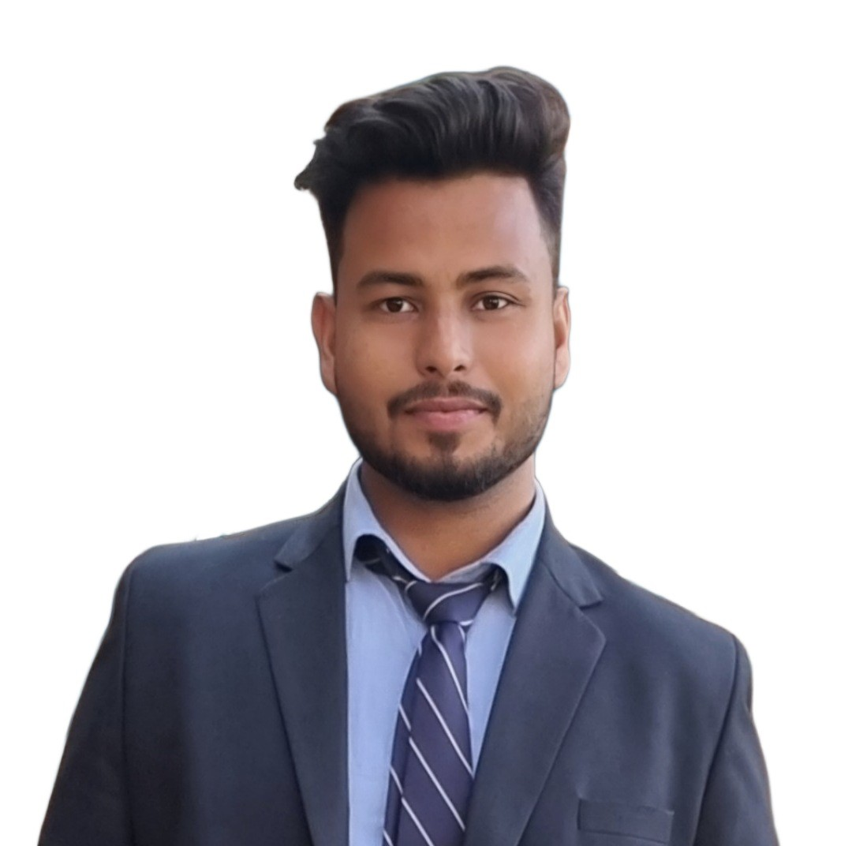



Author
Rohit Kumar
952rohit@gmail.com
8700025053
I would like to extend my special thanks to my mentor,
Parth Verma, for his invaluable support and guidance.

